Slide 1
Individual Project
SDBDA 10233443E T01 Muhammad Afiq Bin Mohamad Mansor

Slide 2
Business Problem
Main Problem 1: What are the trends in the Coffee Market.
Main Problem 2: What are the trends of Price and Cost in the Coffee Market.
Objectives: The objectives of the Business Problem is to analyse who are the major exporters and importers of Coffee in a global scale and also gain an insight on the prices and costs involved in the Coffee Market from 2008 to 2018.

Slide 3
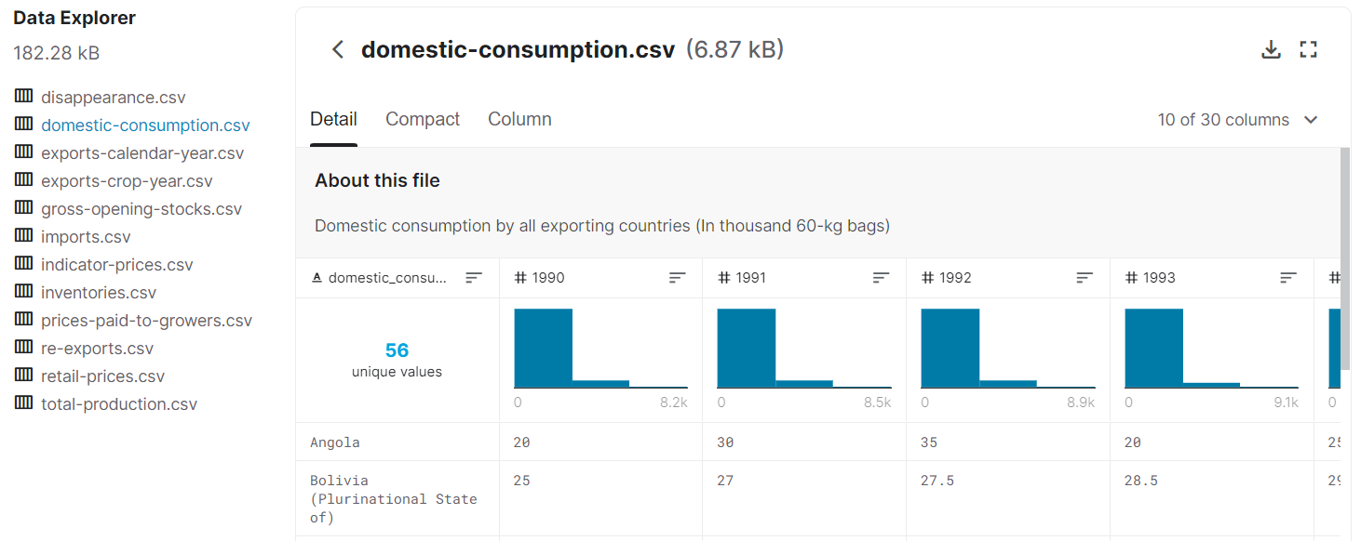
Data Preparation
The Data used is International Coffee Organisation (ICO) Coffee Dataset obtained from kaggle.com. (ICO Coffee Dataset (Worldwide) | Kaggle)
Data came in different excel sheets with 1 parameter per sheet.
Some sheets had some missing data entries. Missing data was looked up and obtained/ patched from original source, ICO.org. International Coffee Organization - Historical Data on the Global Coffee Trade (ico.org).

Slide 4
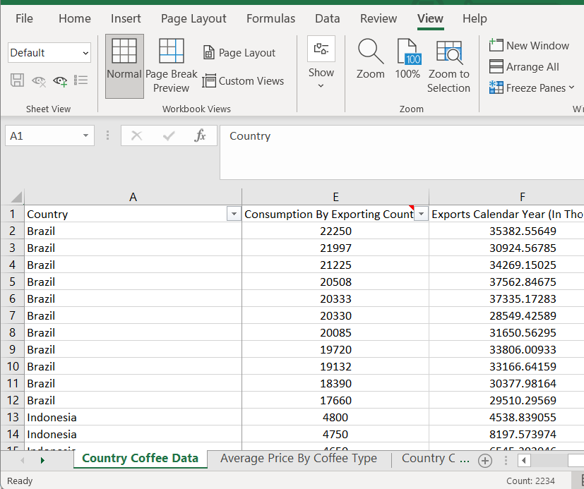
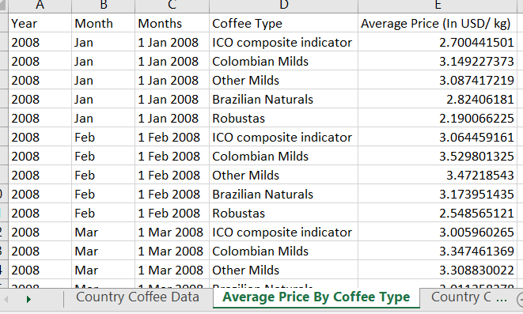
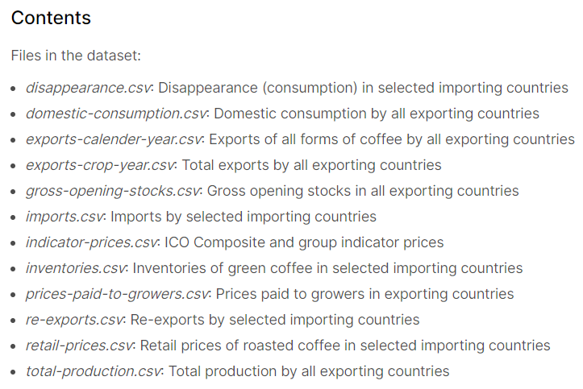
Data Preparation
Combined all data into 1 excel sheet ‘Country Coffee Data’ (VLOOKUP, MATCH excel functions).
A second sheet ‘Average Price By Coffee Type’ breaks down Coffee prices by type.
Inserted units as per information page on kaggle.com.
Filled in respective continents of listed countries.

Slide 5
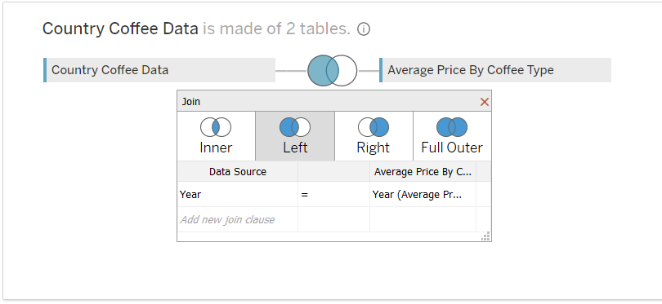
Data Preparation – Tableau Left Join
In Tableau, a Left Join is used to combine the 2 sheets ‘Country Coffee Data’ and ‘Average Price By Coffee Type’.
The joining parameter is ‘Year’.

Slide 6
Main Problem 1/ Dashboard 1
Main Problem 1: What are the trends in the Coffee Market.
Sub Problem 1: Breakdown of Coffee Exports by Region/ Continent.
Sub Problem 2: Major Exporters of Coffee.
Sub Problem 3: Top Importers of Coffee.
Main Problem 1/ Dashboard 1 analyses who are the top exporters and importers of Coffee on a global scale from 2008 to 2018.
Analysis/ Conclusion: We can see from Dashboard 1 that major exporters of coffee are from the Americas and Asia region with countries like Brazil, Colombia and Indonesia among the top countries exporting coffee.
In terms of imports, we see that USA is a top importer of coffee followed by Germany with import quantities exceeding the Asian region and other countries.

Slide 7
Main Problem 2/ Dashboard 2
Main Problem 2: What are the trends of Price and Cost in the Coffee Market.
Sub Problem 1: Retail Prices of Coffee.
Sub Problem 2: Cost Paid to Coffee Growers.
Sub Problem 3: Coffee Price by Coffee Type.
Main Problem 2/ Dashboard 2 gives an insight on the prices and costs involved in the Coffee Market based on 2008 to 2018.
Analysis/ Conclusion: We can see that growing cost directly affects the price of coffee. We can see in 2011 in particular we have a spike in growing cost which resulted in a spike in coffee price across all coffee types.

Slide 8
Tableau Features Used – Dashboard 1
Filter – Dropdown, multiple to select years we are interested in.
Filter – Pie Chart (SP1) to filter all charts in Dashboard 1 by countries in selected region/ continent.
Parameter – Top N (slider) to select top number of importers of coffee(e.g. Top 3, Top 10, etc).
Calculated field + parameter – Calculated field ‘c_Performing Countries’ using IF, ELSEIF logic to colour code countries by major or minor/ non exporter. Linked to parameter ‘Export Threshold’ (slider) to set what is the threshold. Colour changes accordingly.
Dashboard action – To go to Dashboard 2.

Slide 9
Tableau Features Used – Dashboard 2
Filter – Dropdown, multiple to select years we are interested in.
Reference Line + Parameter + Calculated Field for Retail Price – Reference Line that changes position on chart based on value typed into parameter ‘Retail Price Reference Target’ and changes colour of data accordingly based on the position of the line (Calculated Field ‘c_Retail Price Reference Line’ with IF, ELSEIF logic).
Reference Line + Parameter + Calculated Field for Cost Paid to Growers – Reference Line that changes position on chart based on value typed into parameter ‘Cost Reference Target’ and changes colour of data accordingly based on the position of the line (Calculated Field ‘c_Cost Reference Line’ with IF, ELSEIF logic).

Slide 10
Tableau Features Used – Dashboard 2 Continued
Icons – Icons with filter function to filter respective graph when click on icon.
Average Lines.
Dashboard action – To go to Dashboard 1.

Slide 11
Sources/ Citation
Data source International Coffee Organisation (ICO) Coffee Dataset obtained from kaggle.com. (ICO Coffee Dataset (Worldwide) | Kaggle)
Patching of some missing data points are obtained from ICO.org. International Coffee Organization - Historical Data on the Global Coffee Trade (ico.org)
All Icons are from Free Vector Icons and Stickers - PNG, SVG, EPS, PSD and CSS (flaticon.com)

Slide 12

Thank you

